Slide 1
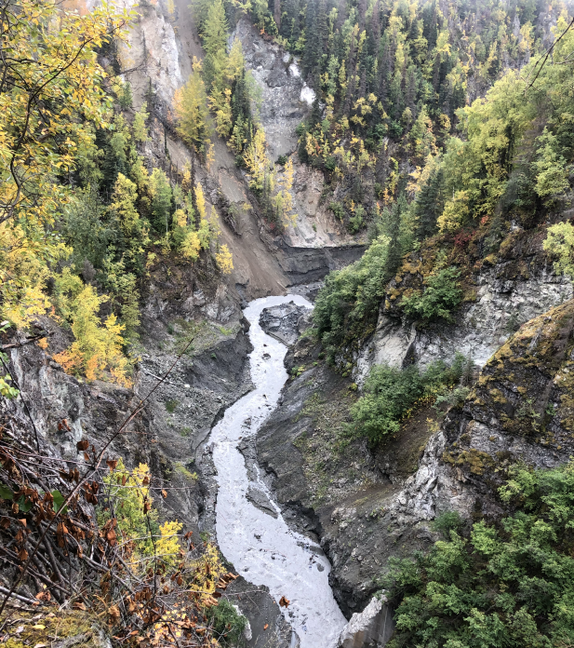
In Relation to Water Indigenous Leadership in Restoring and Re-envisioning Watershed Stewardship
Beth Rose Middleton Manning, Professor
Dept. of Native American Studies
University of California, Davis

Slide 2
We should take a moment to acknowledge the land on which we are gathered. For thousands of years, this land has been the home of Patwin people. Today, there are three federally recognized Patwin tribes: Cachil DeHe Band of Wintun Indians of the Colusa Indian Community, Kletsel Dehe Wintun Nation, and Yocha Dehe Wintun Nation. The Patwin people have remained committed to the stewardship of this land over many centuries. It has been cherished and protected, as elders have instructed the young through generations. We are honored and grateful to be here today on their traditional lands.
Importance of land acknowledgement
Land acknowledgement as a first step

Slide 3
In Relation…
Indigenous perspectives on relation and responsibility– local/ regional cultural practitioners including Diana Almendariz and Ron Goode, and authors including Melanie Yazzie & Cutcha Risling Baldy, Zoe Todd, Dan Wildcat, and many others
My discussion of relation references those perspectives (including epistemologies of kinship and reciprocity, frameworks of sovereignty) and takes a political ecological (politics, economy, ecology) approach-- considering how infrastructure (dams) and policy (water, fire) reveal a relation to water
How might we better understand this relation, and its impact on environmental injustices, and shift into a more respectful relation?

Slide 4
A moment of reckoning
Truth and Reconciliation– Truth and Healing Council, Reparations Commission, Statue toppling, emphasis on police accountability, Boarding School recognition, 1619 Project…and more
Adding to that conversation--- the history of hydroelectric infrastructure imposed with no Free, Prior, and Informed Consent, and its ongoing impacts, exacerbated by climatic change and water quality concerns
Project goals:
Place each River/ project in deep historical context, documenting the ways in which the water and the human community were manipulated to benefit a generally narrow “public” that did not include Indigenous peoples or people of color.
Identify the institutions, processes, relationships, funding, that are supporting multi-year dam removal and river restoration efforts.
Inform inclusive, historically-responsive policy development that recognizes Indigenous leadership of large-scale dam removal and river restoration projects.
Develop tools to support collaborative dam removal with and by tribal partners.
Advocate for additional funding and policy support for tribally-led dam removal and restoration.
From dams as a tool of removal, to dam removal as a way to sustain people and communities.

Slide 5
The stakes are high…
Climate is changing– increasing temperature, increasing aridity, increasing variability/ unpredictability
Subsistence and cultural uses of water are increasingly threatened by water quality and quantity
Ecosystem resilience requires addressing the impacts of aging hydroelectric and water diversion and storage infrastructure, in a way that does not reproduce embedded discrimination, exclusion, and inequalities.
Environmental restoration can only be discussed alongside attention to the violence of infrastructure projects that benefited a narrow segment of the population, with lasting impacts.
Healing from dam removal and restoration is multifaceted, with intertwined ecological, economic, social, and cultural aspects.

Slide 6
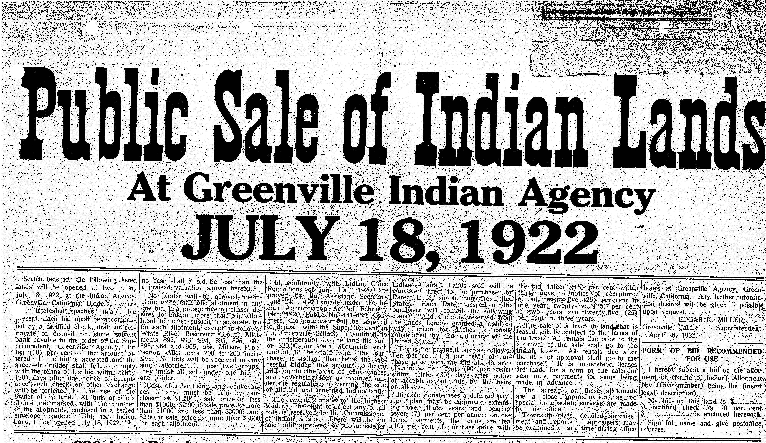
Context: Western Water Development
1888 Congressional appropriation to the DOI to study the irrigation potential of Western lands. The appropriation asserted that all lands deemed potential sites for water projects, and potentially irrigable, be reserved from settlement.
Bureau of Reclamation’s first Director, Francis Newlands, worked with Frederick Newell, US Geological Survey, in 1900 to develop a “national irrigation bill that could be funded from the sale of public lands” (Rowley, William D., 1996, Reclaiming the Arid West).
1901 hearings on the proposed Reclamation Act (passed 1902) contemplate “receipts from the sales of public lands in the arid and semiarid regions of the US” will be put “to the exclusive purposes of irrigation.”
This was formalized into a specific fund in the Treasury, the “arid land reclamation fund,” for the development of reservoirs and “other hydraulic works” for irrigation and “reclamation of arid lands.”
Native American homelands were thus claimed as “public” land and sold to provide revenue to fund large water projects that would in turn support the settlement and development of the West by “a most desirable class of people”
Notes:
Indian lands were allotted by the Bureau of Indian Affairs, then either cancelled by the Agency and transferred to or sold to RRLC, which harvested the timber, and sold the land to GWP.
1901 hearings on the proposed Reclamation Act (passed 1902) clearly contemplate that “receipts from the sales of public lands in the arid and semiarid regions of the US” will be put “to the exclusive purposes of irrigation.” This was formalized into a specific fund in the Treasury, the “arid land reclamation fund,” for the development of reservoirs and “other hydraulic works” for irrigation and “reclamation of arid lands.” As such, the process involved claiming Indian lands as “public” land, and then selling those lands to provide revenue to fund large water projects that would in turn support settlement and development of the West by “a most desirable class of people.” Thus, Indians were displaced by both the annexation of their homelands into the federal land base, and the subsequent project development that impacted both their remaining land base and the homelands out of their ownership that they continued to steward.
DOI, GLO, 2/7/1901; see also Rowley 1996: 100, which describes Newlands as working closely with Frederick Newell of the US Geological Survey in 1900 to develop a “national irrigation bill that could be funded from the sale of public lands” (Rowley, William D., 1996, Reclaiming the Arid West, Indiana University Press).

Slide 7
Tribal lands
All homelands, political jurisdiction aside
Lands under tribal jurisdiction
Lands cared for by tribal stewardship, but out of tribal jurisdiction
Lands under tribal cultural or political jurisdiction, impacted by old projects

Slide 8
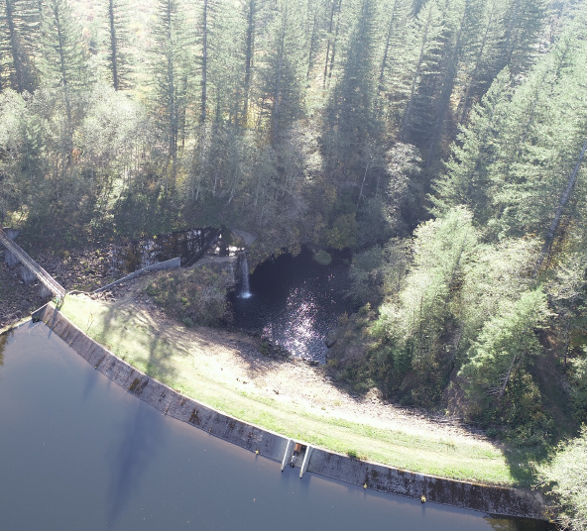
The legacy of dams
Everywhere there is a dam, there is an inundation, a removal of people and ecologies, a legacy of resistance, and a potential to restore
Why dams? Flood control, water storage, hydroelectricity, recreation. How might we address and provide for each of these needs?

Slide 9
Confronting colonial legacies
Seizure of Native lands for hydroelectric and water storage policies
Along with their gathering sites, the Maidu lost salmon and snapping turtles, ceremonies, language, and song—‘everything that goes with the land…We have always been looking for compensation for what we lost. Always. - Lorena Gorbet, Maidu Summit, 2014
Continued denial (by public agencies, conservation entities, private companies, private landowners, institutions, law and policy) of Indigenous rights and responsibilities to tend homelands
Naturalization of settler histories as “always here”
Choice to PERPETUATE or to DISRUPT the exclusion of Indigenous peoples from foundational moments in determining land/water jurisdiction

Slide 10
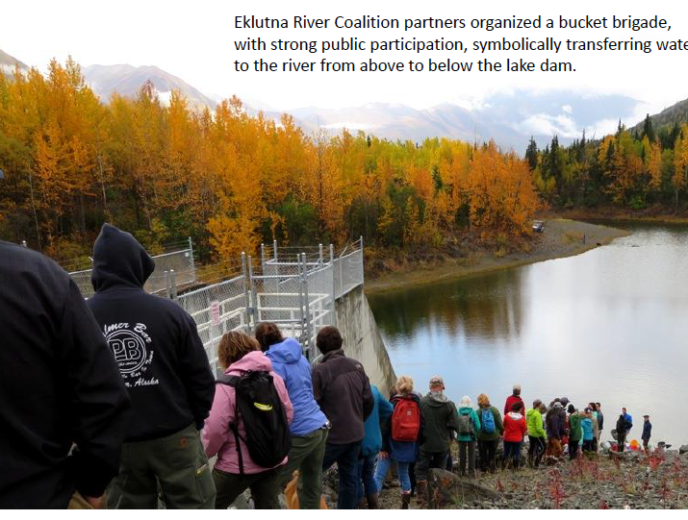
Envisioning new approaches
Consider key moments in project development: licensing, funding, voting, planning, compensation, construction…
What might have been different in those moments to foreground Indigenous objectives, needs, epistemologies?
Will re-examining the past help build alternative futures?
What mechanisms, institutions, and partnerships enable tribally-led dam removals and river restoration?

Slide 11
North Fork Feather River: Stairway of Power and CA State Water Project
~1850-1900: Seizure of tribal lands via nullified treatymaking process, direct violence sanctioned by the state
Tribes excluded from making land claims or gaining associated water rights
Federal reservations of land for possible water projects (1888), condemnation of lands (1901) or withdrawal of lands from settlement if they had hydropower potential (1910)
Private projects built with public reservations of tribal land
State politicians begin advocating for a State water conveyance project (1930s) that would move water from the wet and less populated north to the dry and more populated south

Slide 12
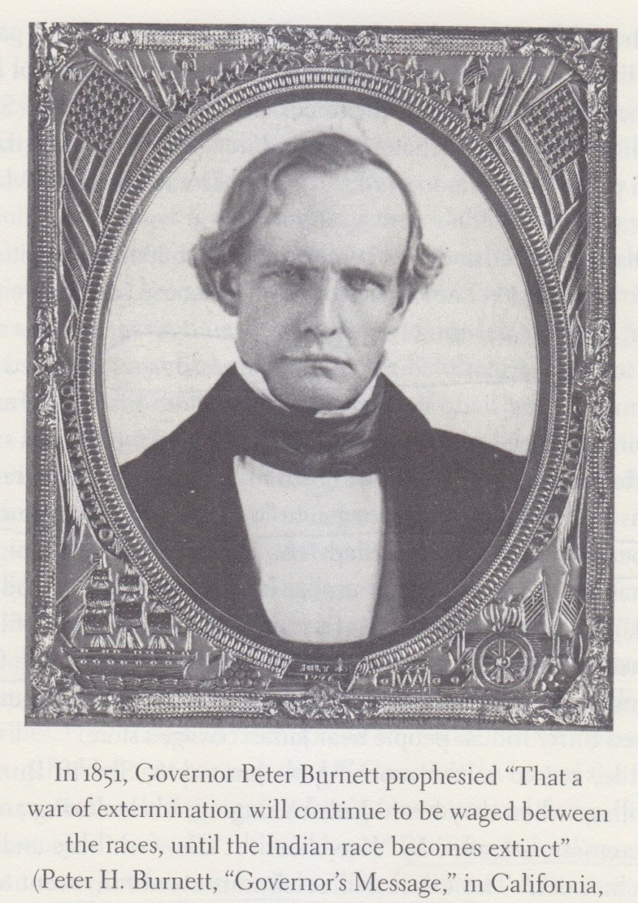
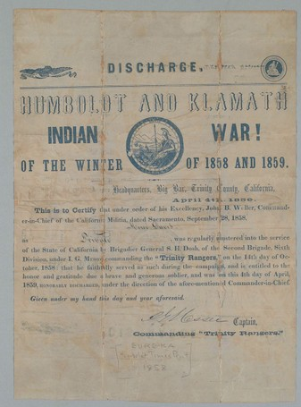

Slide 13
Flooding tribal lands in NE California
PL 109 (1908), “An Act To relinquish, release, and confirm the title of certain lands in California to the Western Power Company” canceled 890 acres of state and federal land and transferred it to the power company.
June 25, 1910 (36 Stat., 847), (power site reserves Nos. 234 and 245): These power-site withdrawals contained about 2,250 acres of lands covered by Indian allotments.

Slide 14
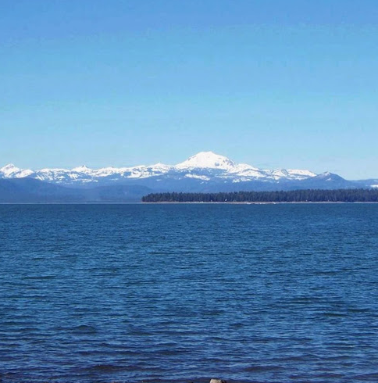
- F. M. Goodwin, Asst. Secy., DOI, to the Commissioner of the GLO, January 20, 1922
Notes:
890 acres condemned and transferred to WPC

Slide 15
L: Individual Indian Allotments in Plumas and Lassen counties, California
Cartography by Michelle Tobias

Slide 16
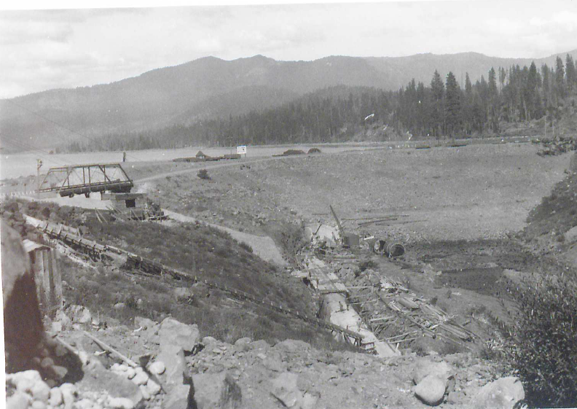
Big Meadows dam construction 1925 (Huber, WRCA)

Slide 17
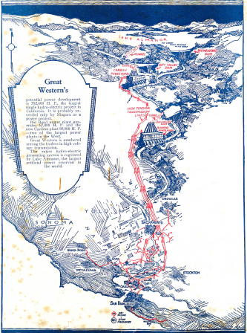
Notes:
Rhodin files
Began in 1880s, engineer noticed its potential, returned in 1901 to study, investor partners filed water rights claim in 1902: Howells posted a notice of appropriation to “100,000 inches of the waters of the north fork of the Feather River for ‘milling, mining, manufacturing, irrigation and domestic purposes and for the purpose of water power and the generation of electric power’” (Coleman 215). WPC formed 1902, GWP 1906
Construction 1911

Slide 18
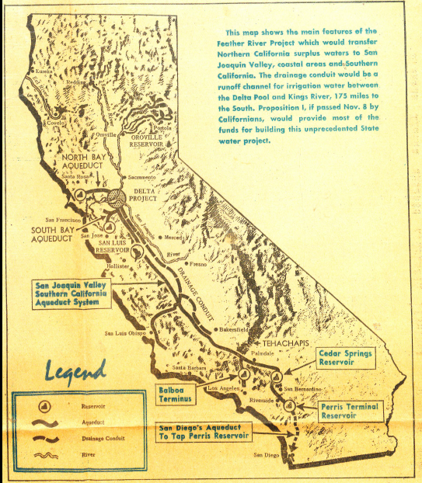
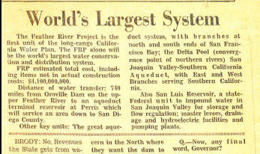
Notes:
The premise of the State Water Plan was to overcome the vagaries of geography and seasonality and move waters north to south to facilitate development and support population growth. A study referred to the Feather River as “the most important tributary of the Sacramento River,” with a huge drainage area and erratic seasonal flows that could be both tempered for flood control and stored to send “surplus” waters to drier areas. As such, the SWP was to kickoff with the Feather River Project, “the first state wide project ever proposed for California,” including the dam at Oroville, planned to be the largest in the US.
(Cooper) Today, the SWP is the “nation’s largest state-built water and power development and conveyance system”
How did the State Water Project come to be? How did Maidu lands come to form the basis of the system? What private and public entities are involved? What entities benefit, what entities lose, and in what ways? How does the way the SWP was developed scaffold the present organization of entities in charge, flows of resources, allocation of costs and benefits, etc.?

Slide 19
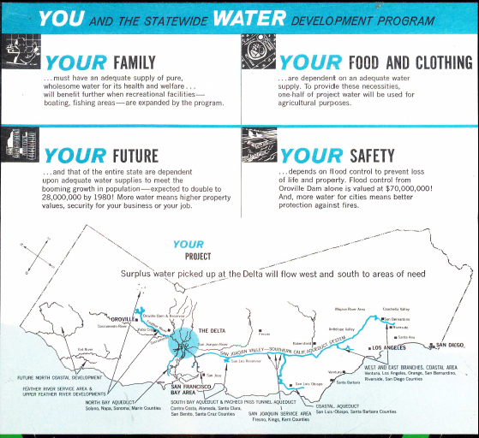
Who is “your”?
Who is the ”public” that will benefit from this project?
…not Native people at the headwaters whose homelands the projects will be built within.
Notes:
(Cooper) At what price? Benefits/costs for whom? Bond passed 1960
Indian histories are rarely part of this discussion, not included, when you are not included from the beginning it makes it hard to disrupt the system later on

Slide 20
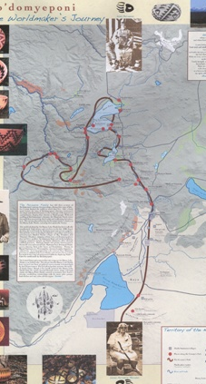
How could the SWP have looked different?
Recognition of: NFFR as Native (Maidu) homelands; impact of successive policy waves resulting in no collective land base; culture-ecology relationship disrupted
Centering Indigenous needs, priorities, epistemologies in planning project: species migration, secure homeland and water rights
Restitution for impacts, both past and negotiated
Mitigation planning so that the least harm is done to cultural places and ecosystems (i.e., AB 32, NHPA)
A different project, maybe not a project, an elsewhere (Decolonization is not an ‘and.’ It is an elsewhere- Tuck & Yang 2012: 36)

Slide 21
We are witnessing a profound and ponderous shift in environmental policy, from viewing rivers as expendable to viewing rivers as living entities that are responsible for diverse human and non-human ecologies.
Elements guiding this shift include:
Ecology, including Traditional Ecology
Native law: personhood of rivers, UNDRIP and FPIC
Economics: diversified sources of energy, regional and global economic dynamics, increasing water use efficiency, expanding technology

Slide 22
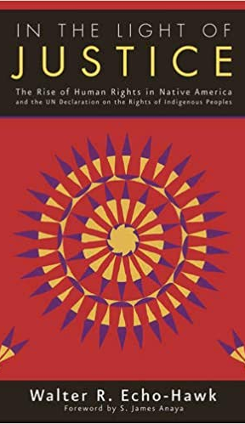
Free, Prior, and Informed Consent in the UN Declaration on the Rights of Indigenous Peoples
Article 10: “No relocation shall take place without the free, prior and informed consent of the indigenous peoples….”
Article 11: ”States shall provide redress through effective mechanisms, which may include restitution, developed in conjunction with indigenous peoples, with respect to their cultural, intellectual, religious and spiritual property taken without their free, prior and informed consent…”
Article 28: ”Indigenous peoples have the right to redress, by means that can include restitution or, when this is not possible, just, fair and equitable compensation, for the lands, territories and resources which they have traditionally owned or otherwise occupied or used, and which have been confiscated, taken, occupied, used or damaged without their free, prior and informed consent.”

Slide 24
Decolonizing Water? Infrastructure and Policy
FPIC in water infrastructure: not part of the early conversation; now there are opportunities to engage in contemporary policymaking, planning
Opportunities for Collaborative Research: Large water projects (SWP, CVP, etc.): Identify opportunities for land restitution and/or Indigenous-led restoration (i.e., relicensing, conservation mandates, etc.): what are the barriers to achieve land transfer or land restoration? How can barriers be overcome?
Action & Education
Share and publicize histories of disenfranchisement as they map on to current configurations of ownership/ leadership; leverage this information to avoid replicating past injustices
Notes:
Its our responsibility, to right historic wrongs

Slide 25
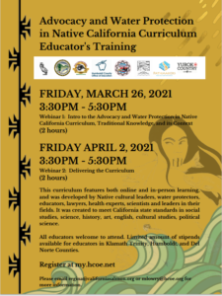
De-colonial re-education on water
Three modules:
The State of California Salmon;
Culture, Advocacy, Environmental Justice for Tribal Communities;
Advocacy and Allyship with Indigenous Movements
https://www.californiasalmon.org/curriculum-advocacy-water-protectio
Notes:
https://545d7da4-5c5c-41b6-8bc8-22f982826406.filesusr.com/ugd/d97ff6_e3da0a5f61914bf18bcd89b25787c036.pdf

Slide 26
Personhood and Relation
In 2019, Yurok Tribe recognized the Personhood of the Klamath River:
“What it means is it gives the right to the river to exist, to flourish and to naturally evolve and a right to a stable climate free from human caused climate change impacts. What that means is that anytime the river is hurt, for example, there's a toxic pollutant that is, gets into the water of the river, we could then bring a cause of action against that polluter to protect the river.” (Cordalis on NPR 9/29/2019)
Impacting environmental policy from Indigenous law and international law

Slide 27
Dam removals: struggles and progress
Open Rivers Fund of Resources Legacy Fund has contributed to 48 dam removals, opening 360 miles of stream, in 54 watersheds throughout the West, provided support for multiple Native nations
Eklutna River dams, Dena’ina (Alaska)
Kwoneesum Dam, Cowlitz, Wildboy Creek, Washington
Matilija Dam, Chumash (California)
Pending permissions, goal to also include:
Rogue River dams, Cow Creek Band of Umpqua, Oregon
Snake River dams, Nez Perce, Idaho
Klamath dams, Yurok and Karuk, California

Slide 28
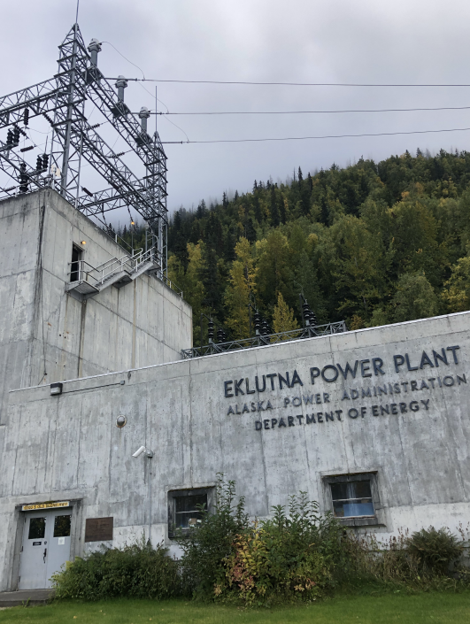
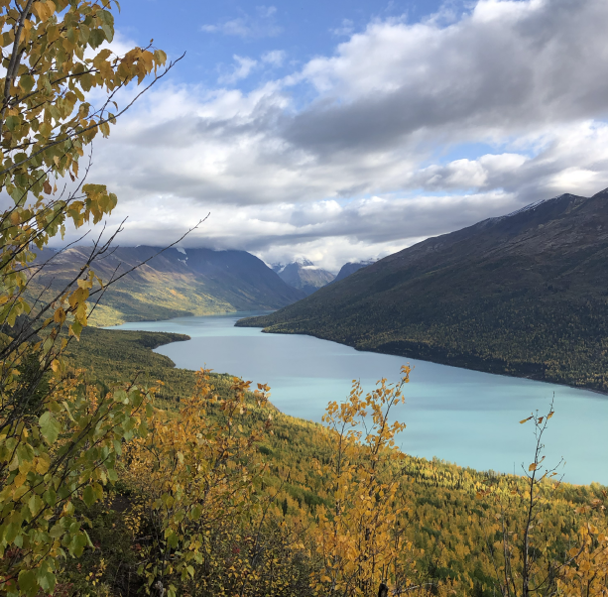

Slide 29
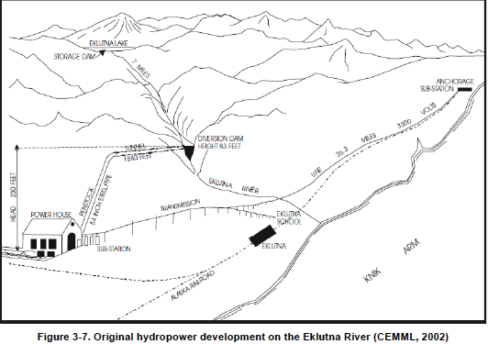

Slide 30
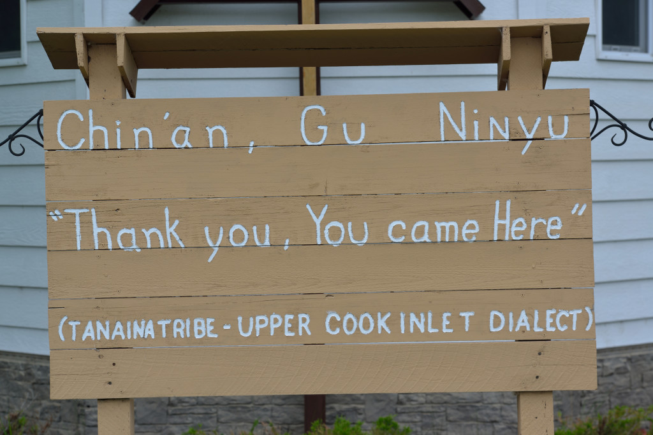
Eklutna River salmon have been a central to Dena’ina lifeways since time immemorial.
NVE formed and coordinate Eklutna River Watershed Council and Eklutna River Committee (partners include Conservation Fund, Trout Unlimited, and Alaska Center)
NVE has been advocating with utility companies, with support from Eklutna Inc. and Conservation Fund.
NVE President Aaron Leggett: We want to bring back salmon populations for Dena’ina and Alaskans. The Tribe is very pleased that progress is being made toward restoring the Eklutna River, and are hopeful that the salmon will return to us. (2021 NVE)
2021 Alaska Federation of Natives endorsed restoration of Eklutna River
A sign welcoming guests to Eklutna’s historical park (CIRI).
Notes:
https://www.ciri.com/our-lands/cook-inlet-areas-and-lands/eklutna/
A sign welcoming guests to Eklutna’s historical park

Slide 31
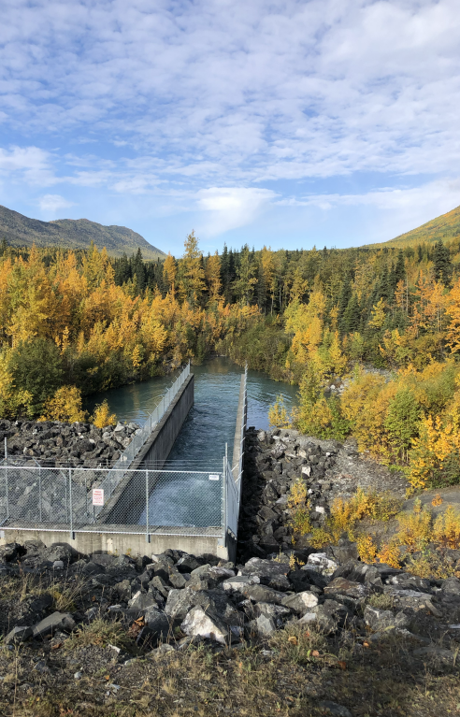
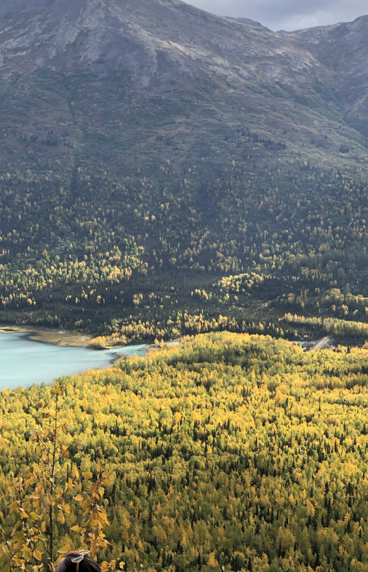
Eklutna Project: Context
June 10, 1920: 41 Stat. 1063, Federal Water Power Act, empowered the Federal Power Commission to license the construction of dams, reservoirs, powerhouses, and other hydropower infrastructure on navigable waters and within public lands and Indian reservations.

Slide 32
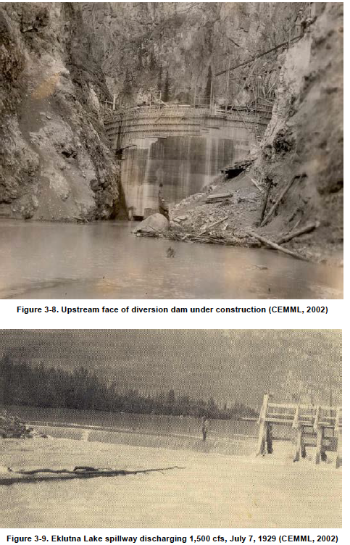
1923: Businessman Frank Reed received a preliminary permit to construct and operate a power project on the Eklutna River. In 1928, the Commission found that the project was well-suited for “water-power development and other beneficial uses,” would not “interfere or be inconsistent with the purpose” of any other affected purpose or reservation, granted a 50-year license.
Dam constructed 1929, in the first year the Company sold over $66,000 worth of energy, to the City of Anchorage, the Alaska Railroad, and the Eklutna School
Storage dam released water from the Lake; diversion dam downstream routed it through the mountain to a power plant

Slide 33
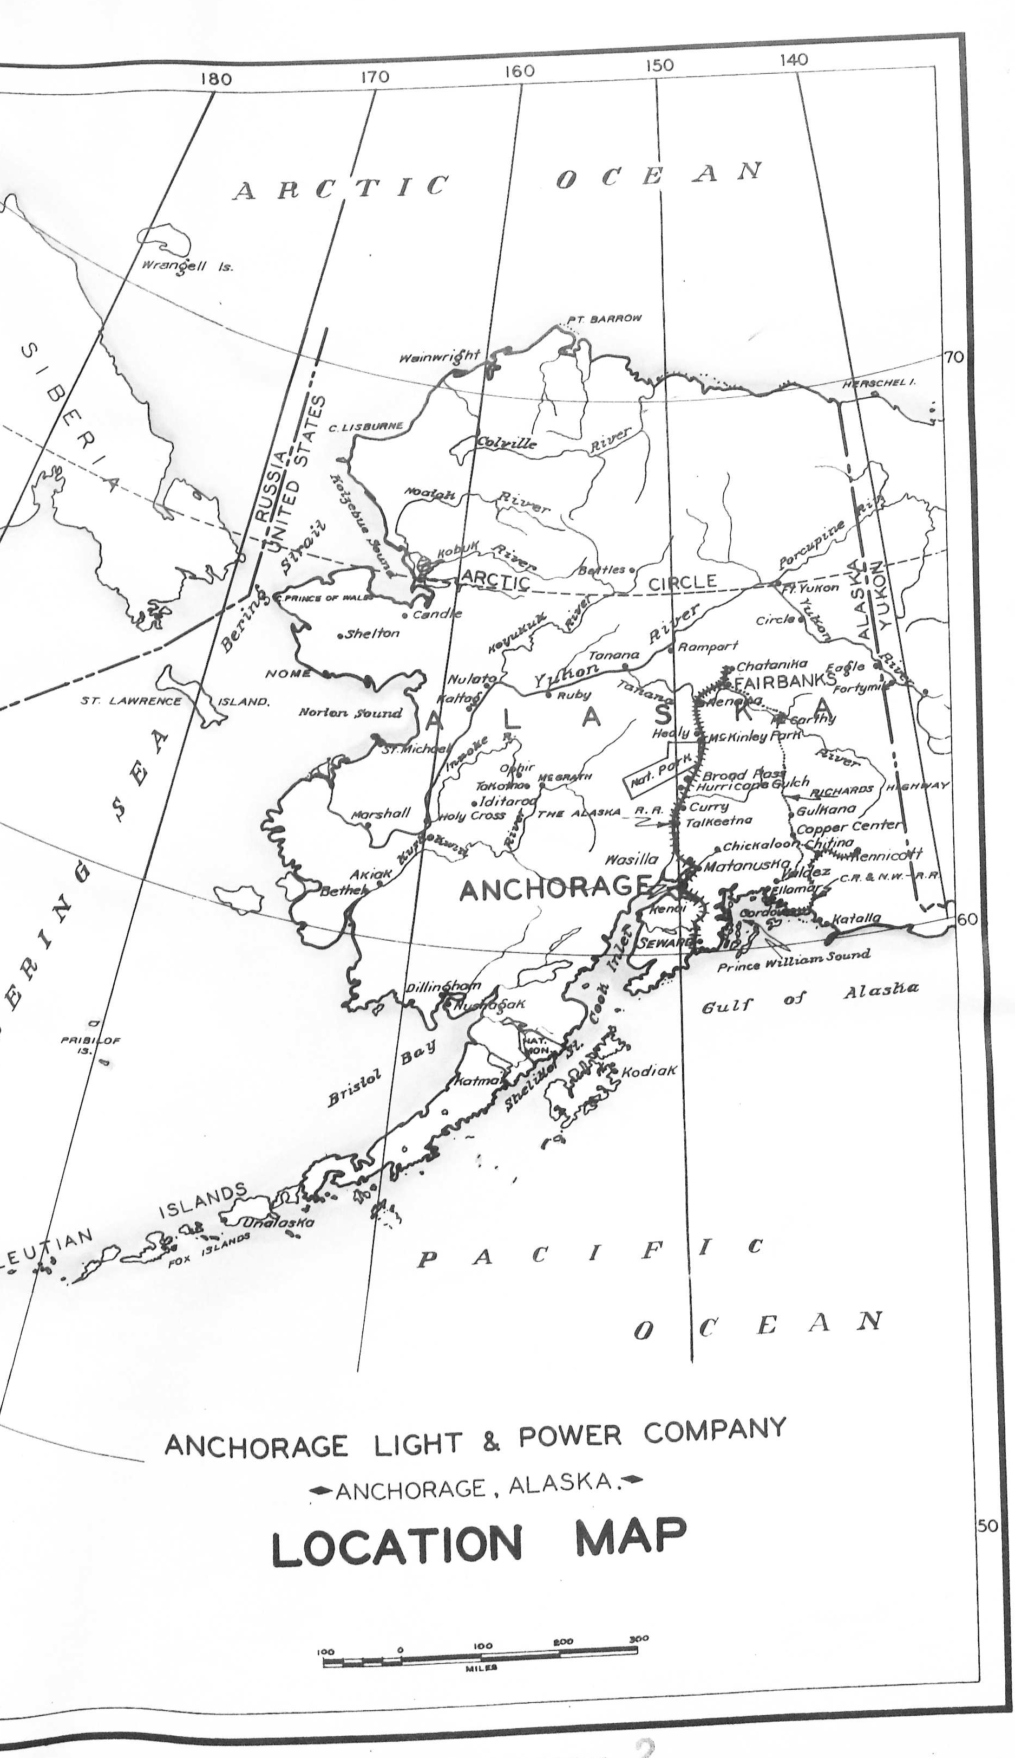
Eklunta
City of Anchorage purchased the system for from Reed in 1943, FPC license transferred
The Bureau of Reclamation aspect of the Eklutna Project was authorized by PL 628 on 7/31/1950 (64 Stat 32) to increase power generation. The resulting concrete dam raised the level of the Lake, moved the diversion outtake to the Lake, and was not designed to release water into the River. The project reserved water rights from the Lake and the River.
BoR consulted with many agencies, including Office of Indian Affairs, which noted that the project would “not conflict with the present Eklutna Indian Reserve,” although the Village is located at the mouth of the River
Federal Eklutna project was first major BoR project outside of the lower 48, did not require an FPC license

Slide 35
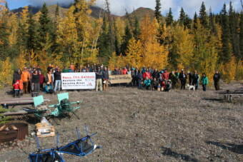
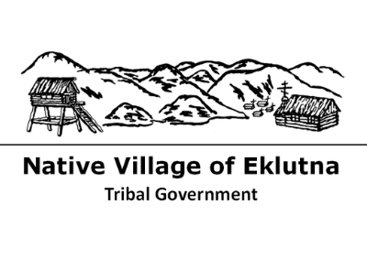
1929 dam: limited salmon to below the lower dam site. Elders remember salmon of all species in the lower Eklutna into the 1950s
1955 diversion: loss of winter rearing habitat, siltation, lack of gravel, low water quantity and quality
Elders including Lee Stephan and Maria Coleman remember salmon in the River into the 1970s

Slide 36
Eklutna
1961 tribal government organized as Native Village of Eklutna
Federal power projects transferred to State administration in 1967. Federal water right traveled with the project.
1971 ANCSA created Eklutna Inc, a Native village corporation. The corporation owns the land around the River and the Lake, State has management authority for 27,000 acres (NALA)
In process of sale to state entities (1987), fish and wildlife agencies were consulted; NMFS identified loss of sockeye run in the Eklutna system, caused by 1929 project, never mitigated.
1991 Fish & Wildlife Agreement required 3 new owners plan to mitigate impacts to fish and wildlife in 25 years (2022), begin implementation in 30 years (2027), and complete implementation in 35 years (2032)
In 2003, NVE applied for water rights to create instream flow reservations for salmonids, not yet adjudicated

Slide 37
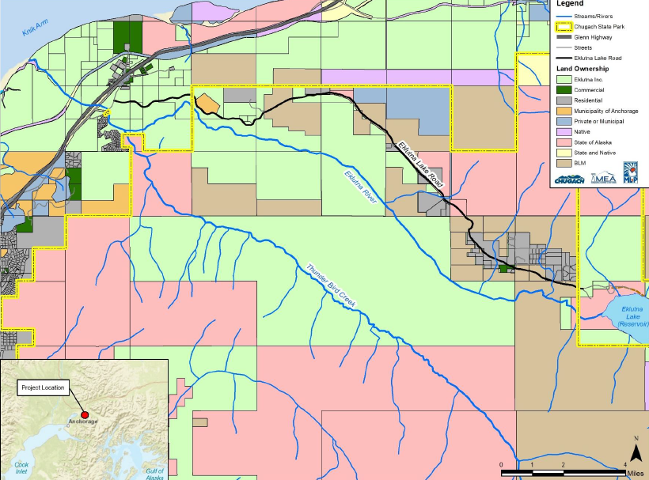
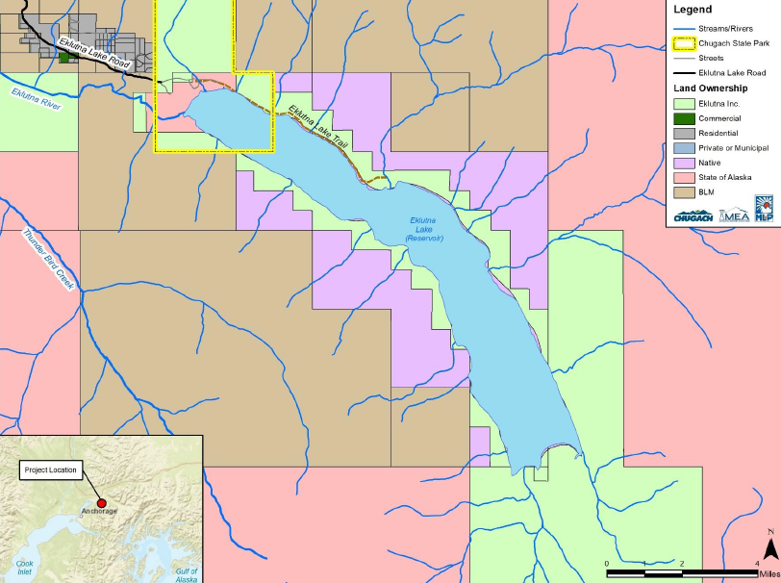
Land ownership maps from the “Eklutna Hydroelectric Project: 1991 Fish & Wildlife Agreement Implementation,” September 2020, pgs. 129-130
Notes:
Final initial information package, Eklutna hydro project, 1991 F&W agreement implementation

Slide 38
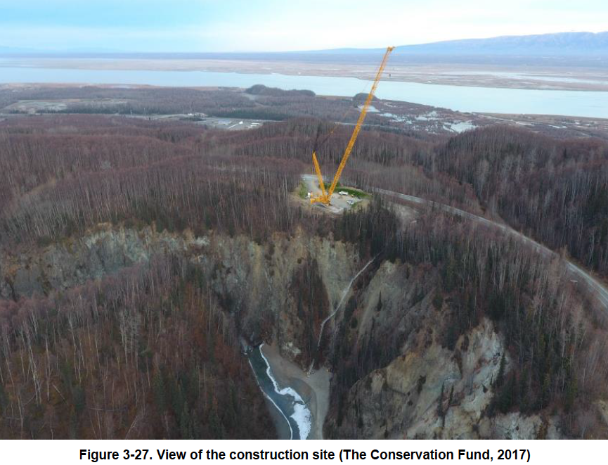
Removing the lower dam
Eklutna, Inc. and Conservation Fund raised $7.5 million to remove the lower dam in 2018, which had been blocking fish passage since 1929

Slide 39
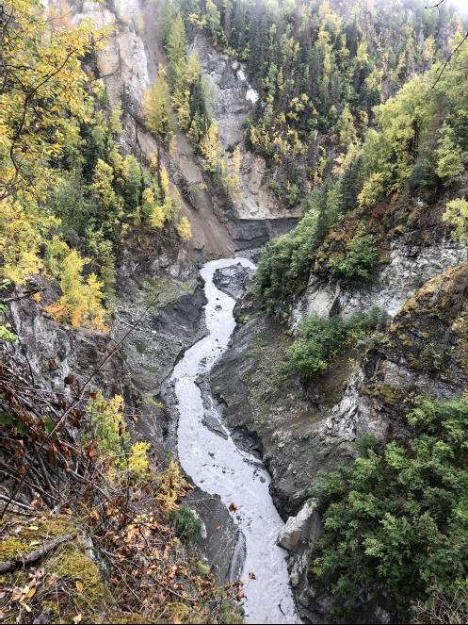
Hydro companies released water in Sept 2021, as part of the studies required by the 1991 agreement.
This was the first time water was flowing in the full stretch of the Eklutna since 1929!
No release was approved in 2022.
Studies of the impact of the 2021 release are ongoing.
L: water flowing in the Eklutna River, 9/2021

Slide 40
Eklutna -- considerations
Approved project (prior to statehood) stopped the flow of the River (with the exception of water contributed by tributaries), and stopped the migration of 5 species of salmon
Eklutna Inc owns the land, but not necessarily management authority
Project impacts conservation values (bordered by a State Park managed area), and municipal needs
1988, Eklutna Water Project completed, diverting water from the Lake to serve City of Anchorage and private water bottling company
10% of water diverted provides 90% of Anchorage water supply; 90% of water diverted is used for power generation
New goals encompass fisheries, hydro, water supply, susbsistence
Navigating conflict between hydro generation and outflow
Proposals include standardizing flow release to maintain salmon populations, and providing fish passage around the upper dam

Slide 41
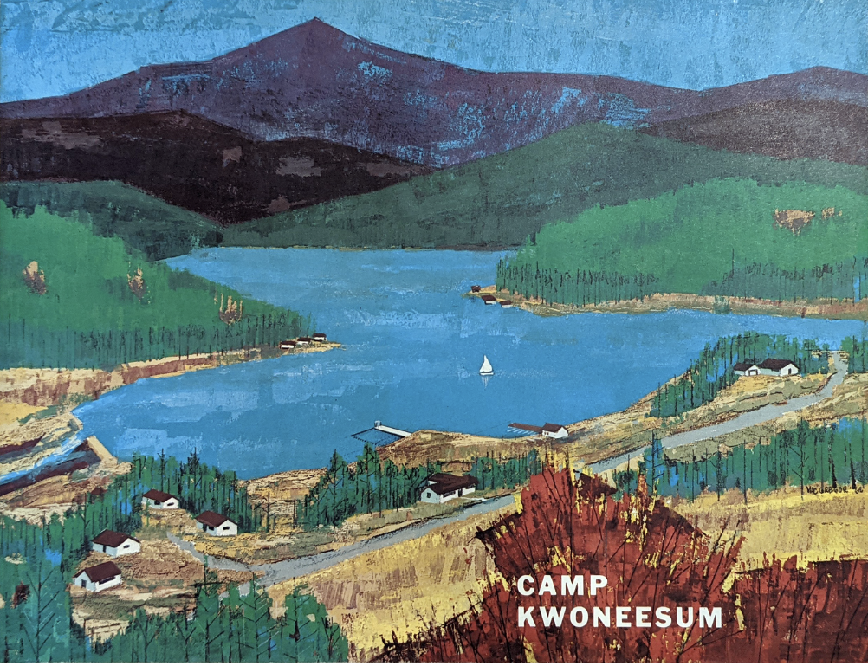

Slide 42
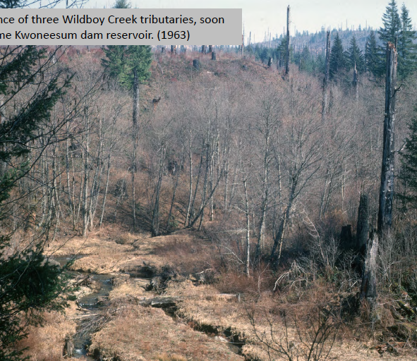
Kwoneesum: Context
Wildboy Creek, tributary to the Washougal River, southwest Washington State
Dam constructed 1964 by Campfire Girls Summer Camp to create 9-acre recreational lake
Dam blocks coho salmon, winter and summer steelhead spawning and rearing habitat, increases water temperature, and there are safety concerns for downstream residents
2018 WDFW report ranked it priority 55 out of 6,181 fish passage enhancement sites
Campfire Girls sold the property in the 1980s, ultimately purchased by Weyerhauser, which sold it to the Columbia Land Trust in 2020
Dam removal would improve water quality, retore salmon habitat. Cowlitz Indian Tribe has created a dam removal design proposal. Working on permitting, with a goal of immediate dam removal

Slide 43
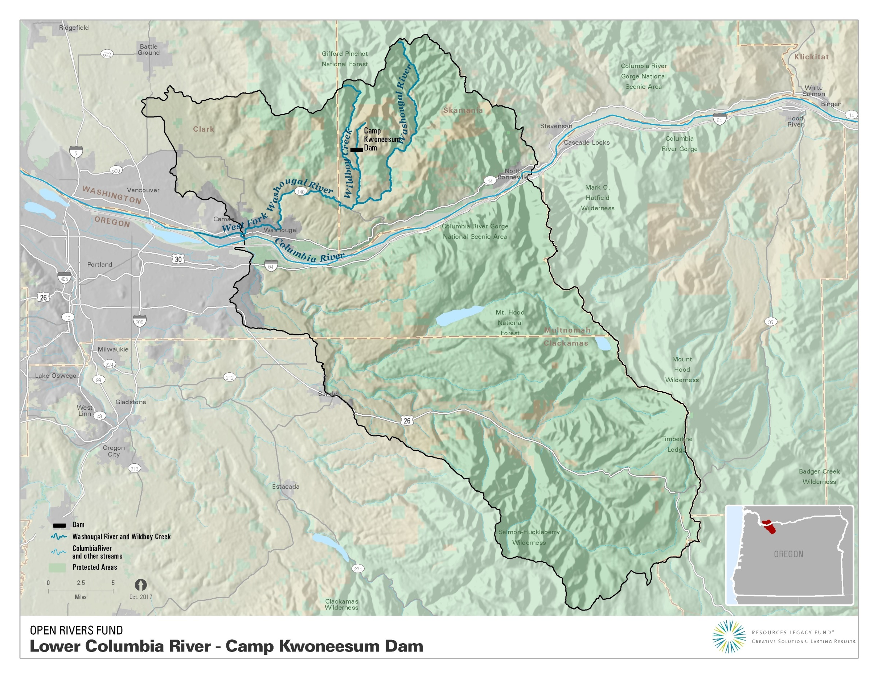

Slide 45
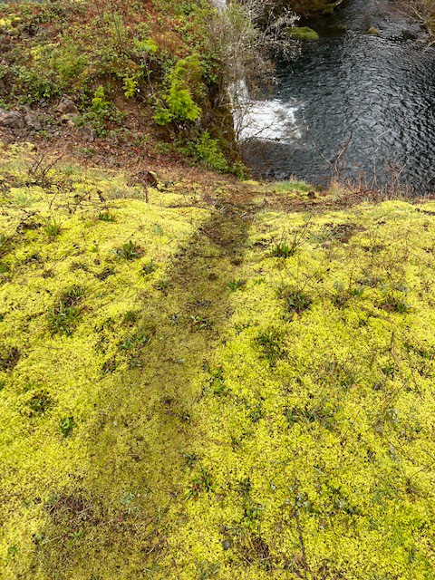
Beaver slide--- some animals are still getting over the dam!

Slide 46
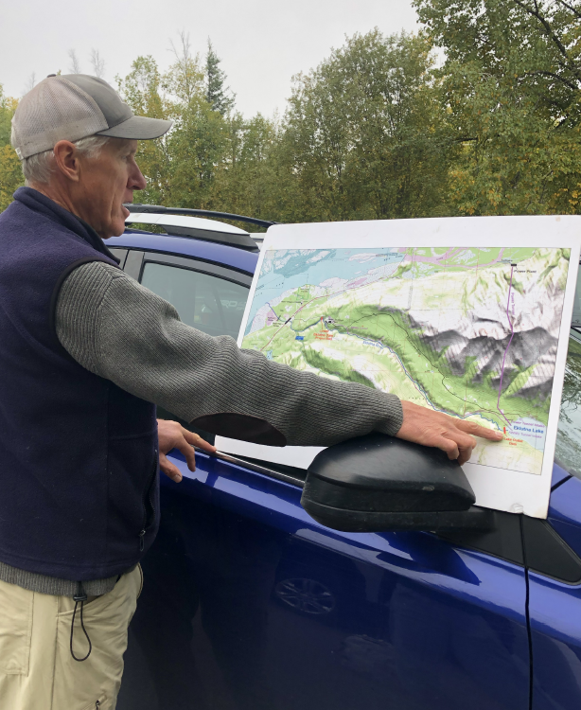
Challenges/ questions in creating alternate futures for dams and river restoration…
Building enduring partnerships
Building trust and agreement between conservation entities and Tribes, and between numerous varied partners who must be involved in dam removals
Replacing dam functions
Water storage, electric provision, recreation/ tourism, flood control--- buffering changes and satisfying customers
Contamination
What is behind the dams? Research, monitoring, risk management and mitigation
Engaging with diverse forms of Tribal governance
Federally recognized and non-federally recognized tribes, Alaska Native corporations and Alaska Native villages
Role of federal recognition and/or corporate status in developing partnerships, fundraising, alternatives to dam functions, de-commissioning
Land Back
Dams are intertwined with displacement. What are the points of interface between dam removals and the Land Back movement?

Slide 47
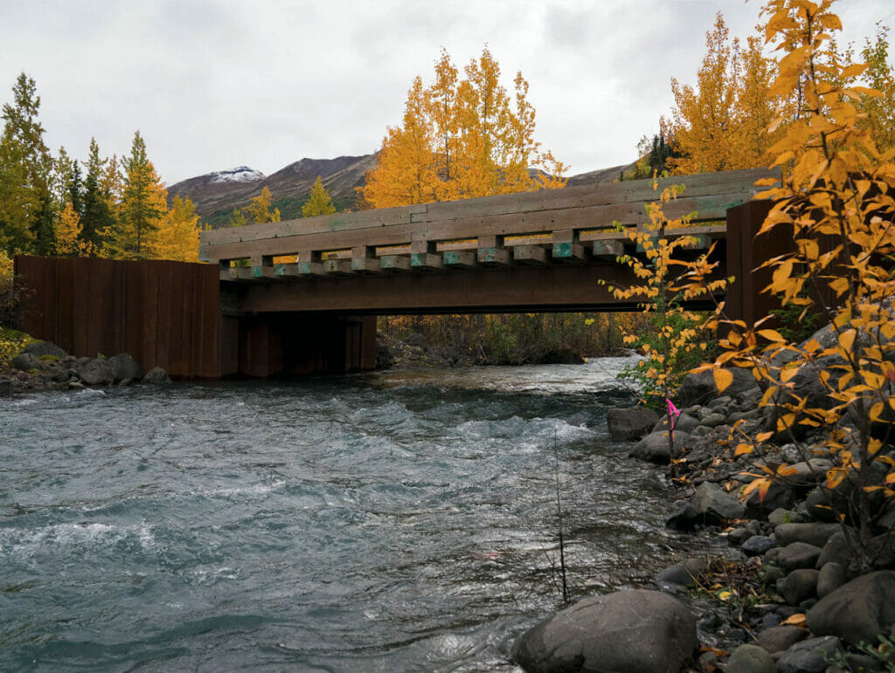
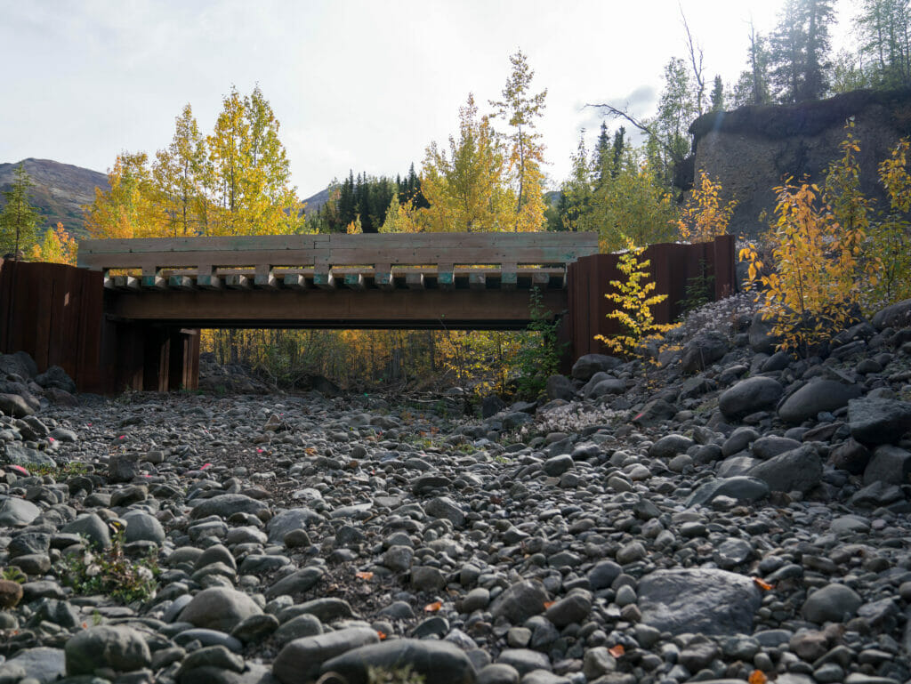
Steps forward/ Steps Back
Cases illustrate wins:
Collaborative land purchases (Kwoneesum)
Achieving vast multijurisdictional agreement (Klamath, Eklutna)
Getting water back in the River (temporarily), and removing a defunct dam (Eklutna)
Cases illustrate challenges:
Jurisdictional constraints, political/economic relationships, and addressing/ offsetting impact on existing uses (Eklutna)
Dueling science or delayed science, as embroiled in politics and economy (Eklutna, Klamath)
Finalizing agreements to get to actual dam removal (Kwoneesum)
Multi-jurisdictional coordination (Klamath: including 2 states, multiple tribes, multiple agencies, and a history of entrenched opposition)
Photos from TU 12/21/21, https://www.tu.org/magazine/conservation/surveying-whats-left-of-eklutna-rivers-salmon/

Slide 48
Conclusions/ next steps
Lasting Western hydro projects were planned during a period of intense colonialism (late 1800s/ early 1900s).
There are many dam removal and river restoration initiatives with substantial tribal participation nationally and internationally (see Fox et al. 2022). This project builds on that work and Upstream’s infrastructure/justice focus to advocate for consistent centering of Indigenous homeland histories and goals
This project is guided by NAIS methodologies and responsibilities, and aims to contribute to a shift in natural resources policy towards justice and accountability
…away from the shortsighted, exclusionary environmental decision-making of the past, to more inclusive, creative, multi-party processes that recognize the potential for building trust across cultures and worldviews to create more just and livable environmental futures.
This project aims to have a very practical element, including key considerations and recommendations for building a comprehensive dam removal and river restoration strategy, while recognizing the unique conditions of each River and homeland.
This project considers dam removals and river restoration in the context of other movements such as #LandBack; Native conservation initiatives such as Native land trusts and Native applications of conservation easements; and the application of UNDRIP and FPIC

Slide 49
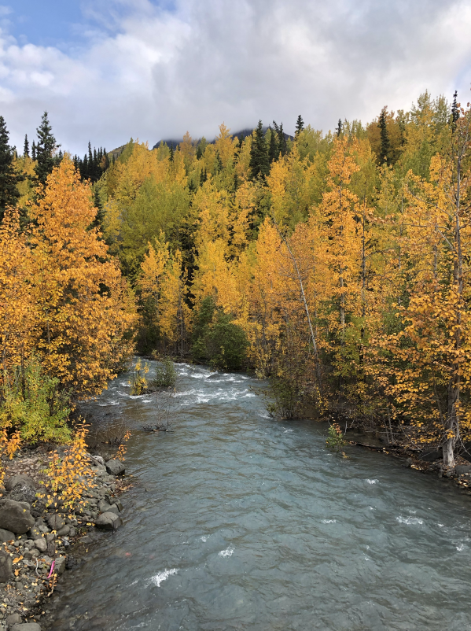
Thank you!
This is an ongoing effort, and I am grateful for the support of Open Rivers Fund and the Carnegie Foundation, the work of GSRs Katt Lundy and Carlie Domingues, the support of my family, and the guidance of community members.

